Slide 1


Picosecond Time-Resolved Studies of Exciton Transport in Conjugated Polymer Nanoparticles
Department of Chemistry
Louis C. Groff II

Slide 2
Outline
Background
Conjugated Polymers & Nanoparticles
Why Study CPNs?
Excited States in CPs and CPNs
Dye-Doped PFBT CPNs
Red-shifted Emission
Complex Fluorescence Lifetime Kinetics
Modeling to Determine Intrinsic L_{D}
Solvent-Induced Swelling of CPNs
Fluorescence Quantum Yield/Spectral Shifting
Picosecond Decay Kinetics
Fluorescence Anisotropy Decay
Lattice Model
Quantum Yield/Mobility Tradeoff
Summary
Acknowledgements

Slide 3
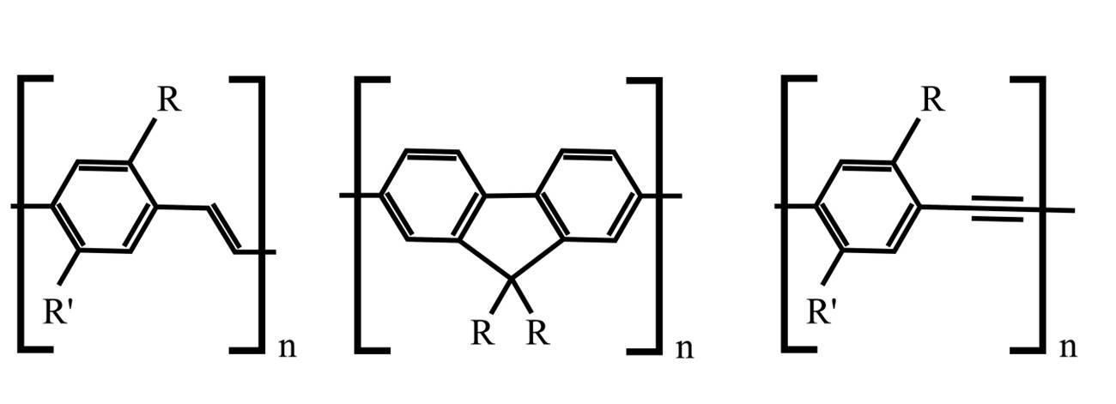
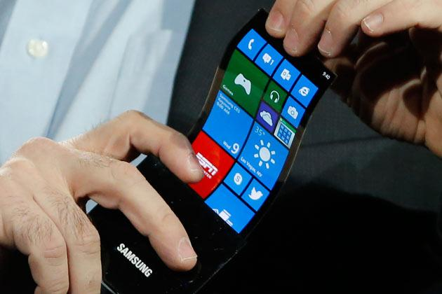
Conjugated Polymers – Basic Photophysics
Background
Plastic, amorphous organic semiconductors
Useful for low cost, flexible photovoltaics, LEDs and solar cells
Repurposing CPs to make nanoparticles
Have many useful optical properties
Flexible Amorphous OLED Screen Prototype
Dennler, G., Sariciftci, N.S., Proc. IEEE 2005, 93 (8), 1429.
Yim, K., Kim, J. S. et al., Adv. Func. Mater. 2008, 18, 1012.
Scholes, G., Rumbles, G., Nature Mater. 2006, 5, 683.
http://s1.ibtimes.com/sites/www.ibtimes.com/files/styles/v2_article_large/public/2014/01/15/samsungflexibleamoledphone.jpg

Slide 4
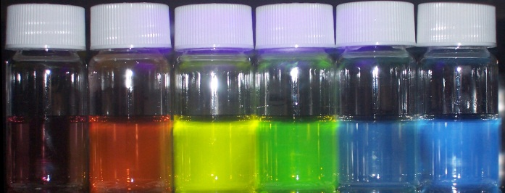
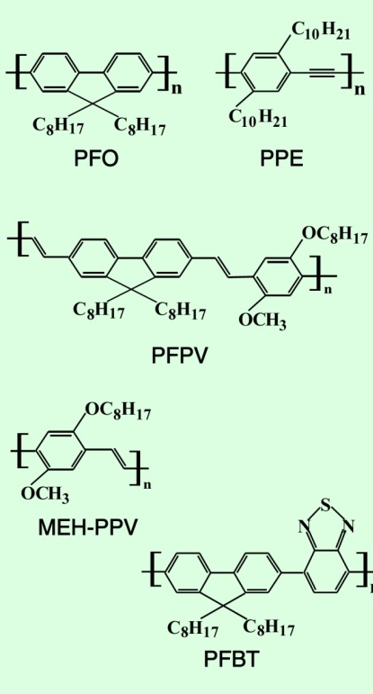

Conjugated Polymer Nanoparticles (CPNs)
Background
Optical Properties
Extended π-conjugated chains
Structure, Heteroatoms: HOMO/LUMO gap in UV/Vis
Wide range of colors
High chromophore number density
Increased by nanoparticle formation
Highly fluorescent
Efficient Förster energy transfer hosts/dopants
Red-shifting, sensors
Wavelength tunability

Slide 5
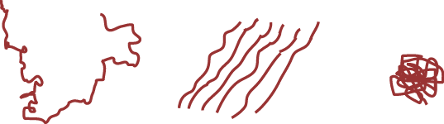
CP Properties and Structure
Solvent-Induced Swelling
conjugated polymer in solution
conjugated polymer film
conjugated polymer nanoparticle
Properties of conjugated polymers depend critically on nanoscale structure, heterogeneity, inter/intrachain interactions and other nm scale processes
Energy transfer and charge transfer
CPNs comprised of one or more collapsed chains
Nanoscale, disordered, multichromophoric system
Studies of single CPNs provide unique perspective on nanoscale phenomena

Slide 6
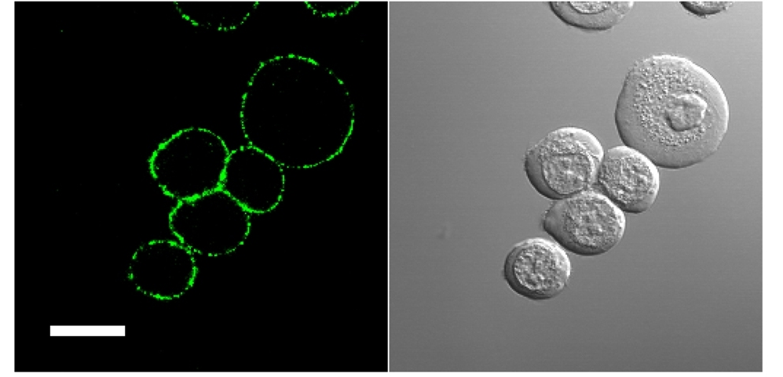
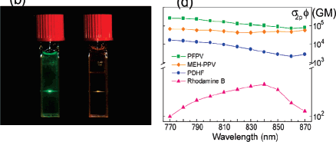
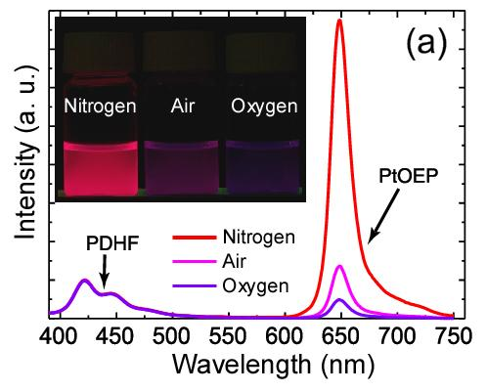
Milestones in CPN Research
Background
Brightest (5-20 nm) nanoparticle probes reported to date
1000x brighter two-photon fluorescence compared to conventional dyes
Effective fluorescent probes for imaging of cancer cells
Novel oxygen sensing NPs
Confocal Imaging of Human Breast Cancer Cells
Two-Photon Brightness Comparisons
Oxygen Sensing CPNs
Wu, C. F., Szymanski, C., Cain, Z., and McNeill, J. D. J. Am. Chem. Soc. 2007, 129, 12904-12905.
Wu, C. F., Bull, B., Christensen, K., and McNeill, J. D. Angew. Chem. Int. Ed. 2009, 48, 2741-2745.
Wu, C. F., McNeill, J. D., Chiu, D. T., et. al. J. Am. Chem. Soc. 2010, 132, 15410-15417.

Slide 7
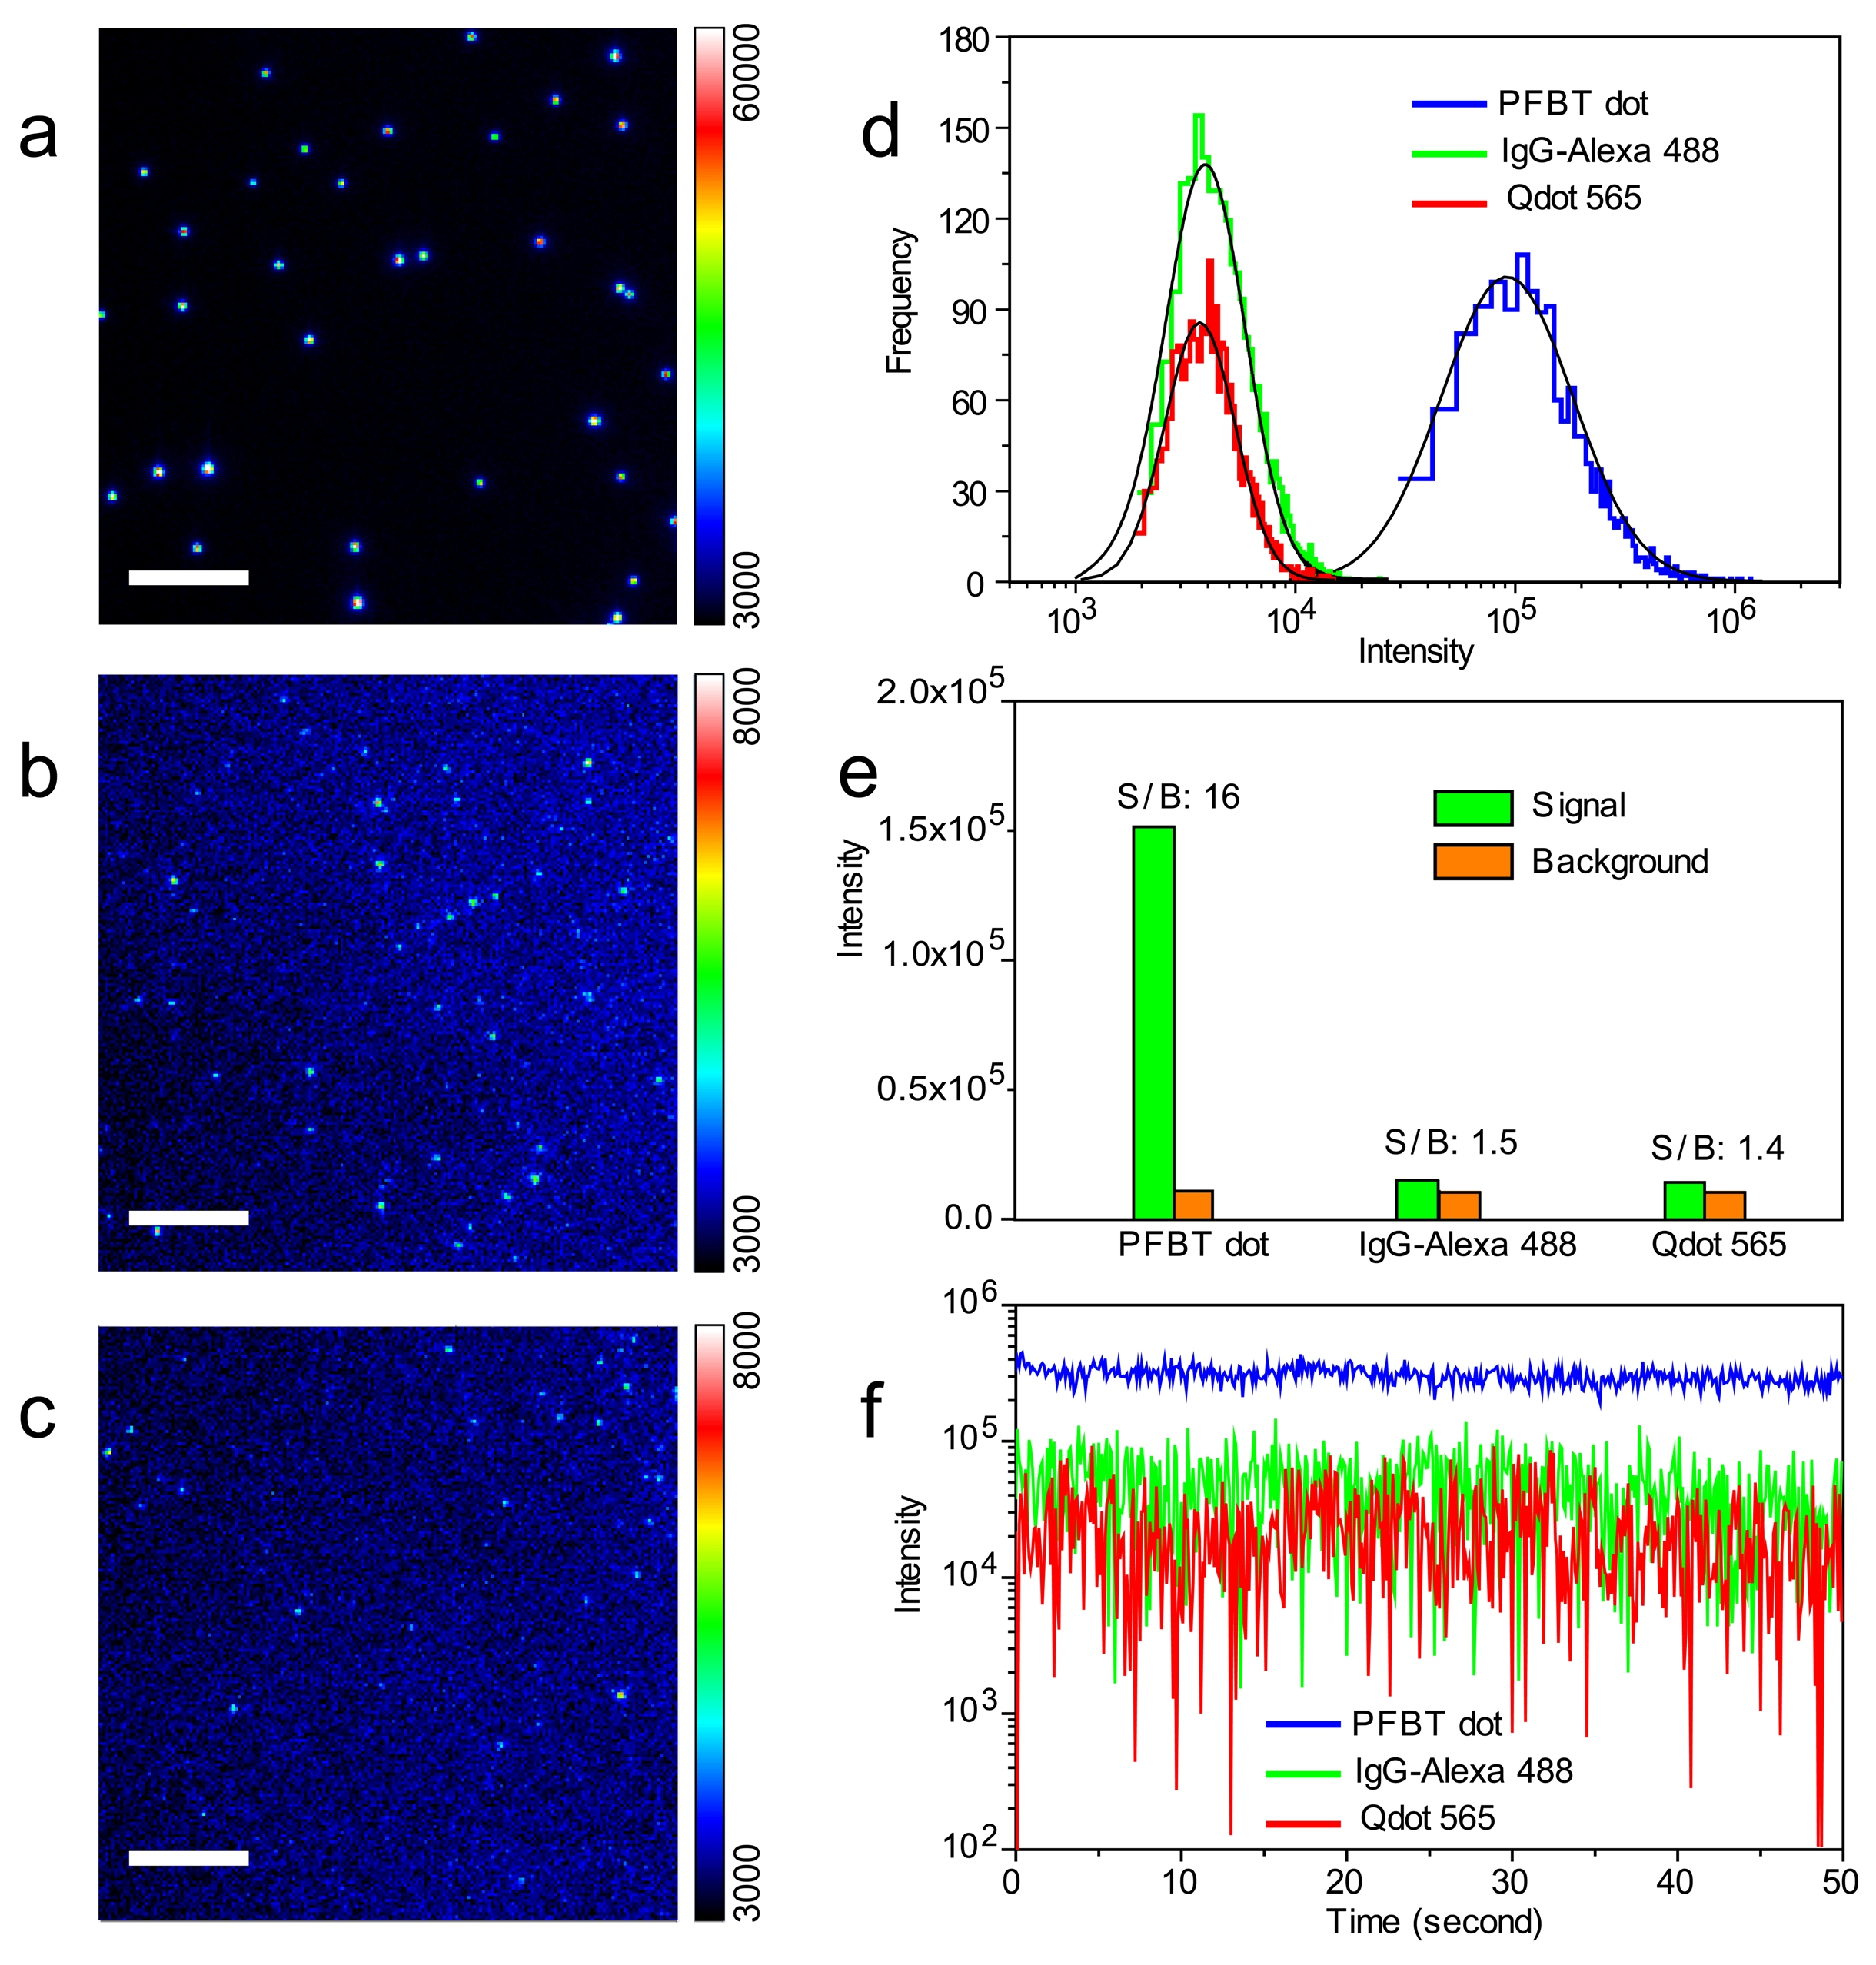
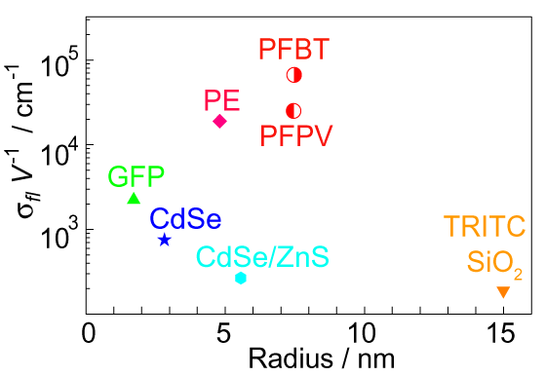
Why Study CPNs? – Imaging
Background
CdSe
Quantum Dots
Brighter fluorescent probes still needed for imaging applications
CPNs are the brightest small fluorescent probes reported to date
30x higher emission intensity compared to Quantum Dots
High quantum yield, fluorescence cross sections
Improvements in quantum yield and photostability are still needed
CPNs
Brightness/Volume Ratios of Various Probes
C. Wu, J. McNeill, Chiu, D. et al., J. Am. Chem. Soc. 2008, 132 (43), 15410

Slide 8
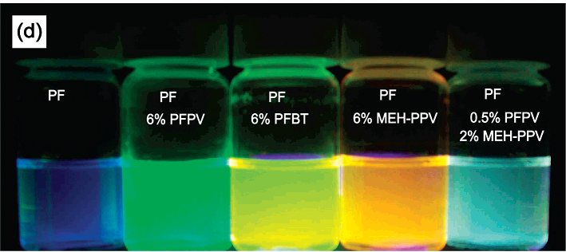
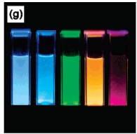
Why Study CPNs? – Imaging
Background
Red-shifting needed for imaging applications
overcome background cell autofluorescence
Improve brightness, photostability
Have previously accomplished this via doping CPNs with other CPs or dyes
Red-shifting of fluorescence via polymer blending
Brighter, more photostable particles via doping
Red-shifting of fluorescence via dye doping
C. Wu, J. McNeill et al., J. Phys. Chem. B 2006, 110 (29), 14148
C. Wu, J. McNeill et al., J. Phys. Chem. C 2008,112 (6), 1772

Slide 9
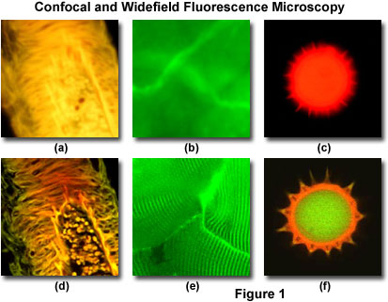
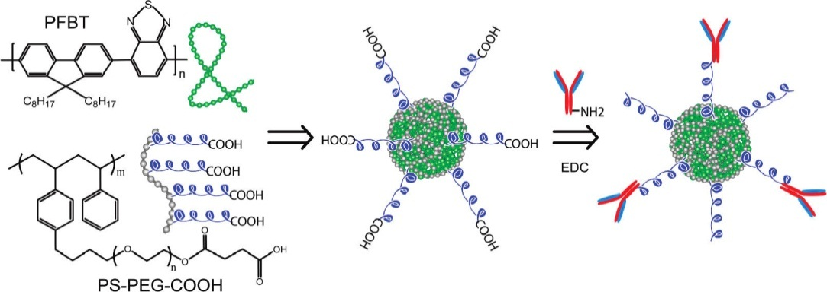
Why Study CPNs? – Imaging
Background
CPNs are non-toxic to cells
No heavy metals
Allows for imaging in live cells
Easily functionalized
Can functionalize or bioconjugate CPNs for use in cellular media
Challenges:
Cell media are complex
Background autofluorescence
Requires bright, red-shifted particles
Wu, C., McNeill, J., Chiu, T. et al., J. Am. Chem. Soc. 2010, 132, 15410

Slide 10
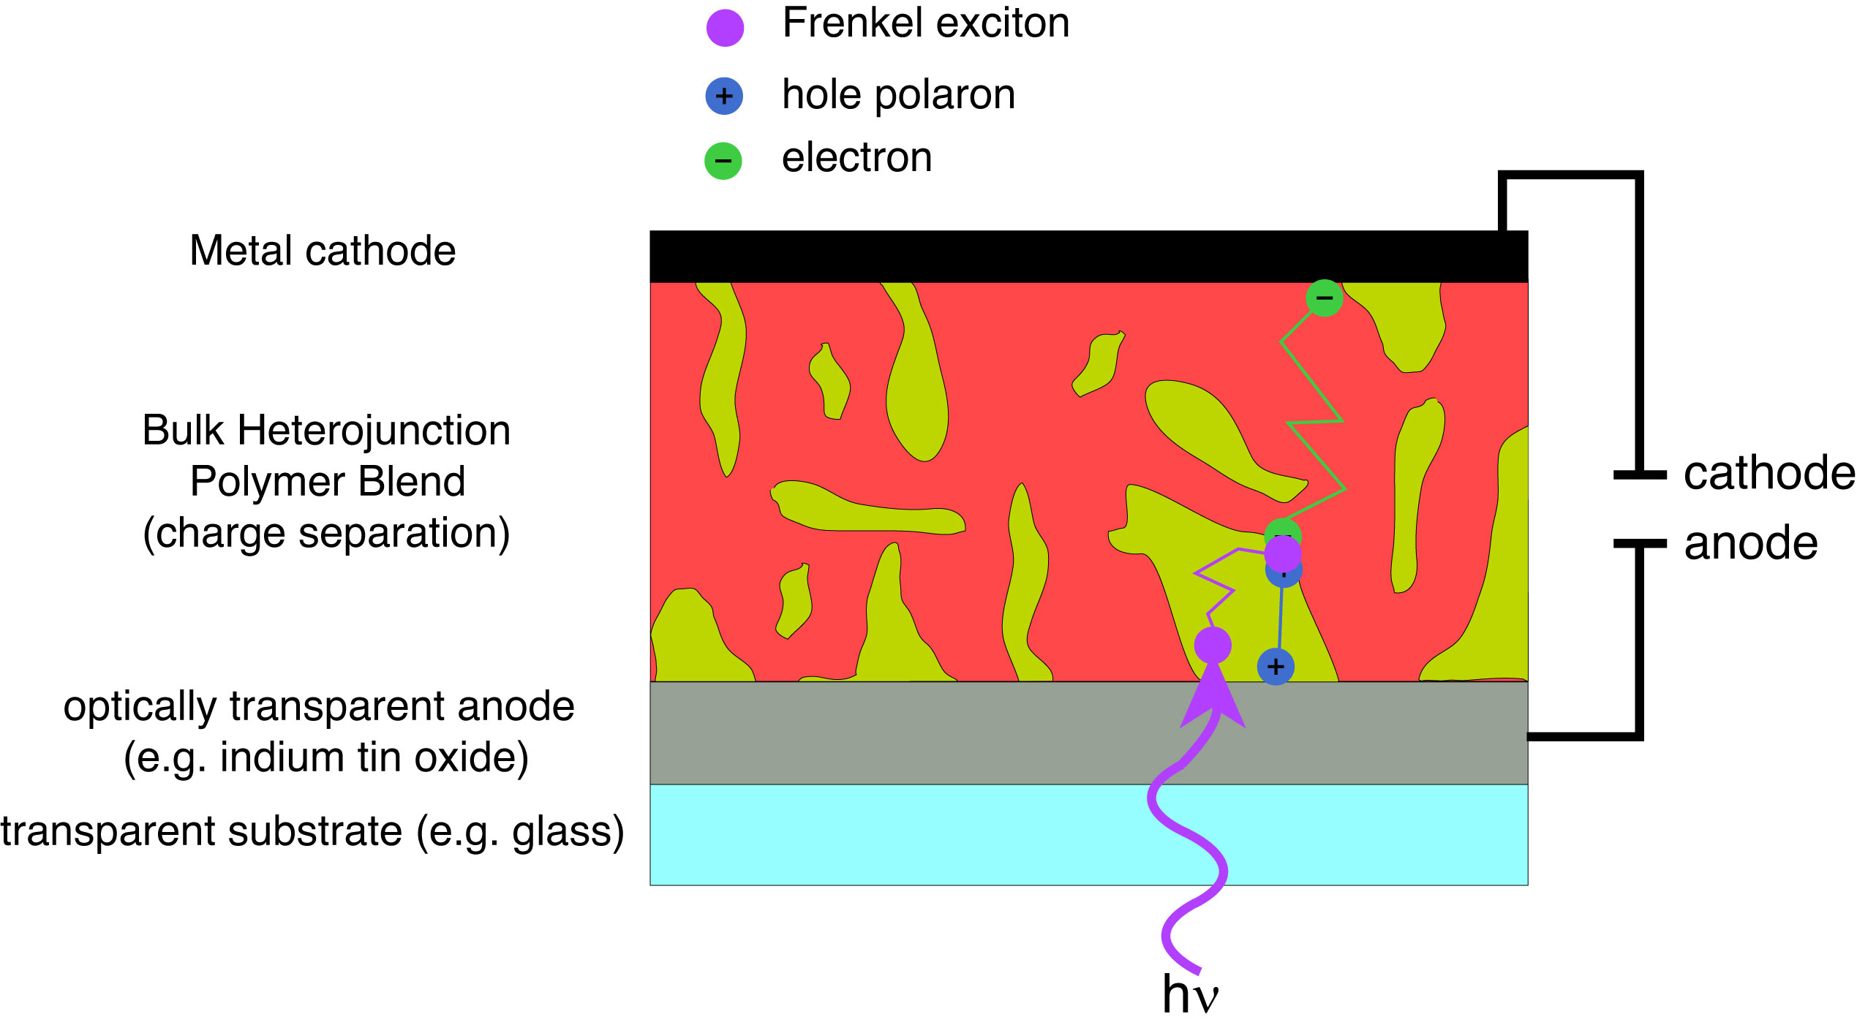
Why Study CPNs? - Devices
Background
Optimize organic semiconductor devices such as LEDs, solar cells
Conjugated polymer devices made by thin film casting
Bulk heterojunction film sandwiched between cathode/anode materials
Photoexcitation of film generates Frenkel excitons
Exciton transport to nano- microscale polymer interfaces
Charge transfer to generate electron and hole pair
Charges travel to cathode/anode materials
Heeger, A. J., Adv. Mater. 2014, 26, 10-28
Günes, S., Neugebauer, H., and Sariciftci, N. S. Chem. Rev. 2007, 107, 1234-1338.

Slide 11
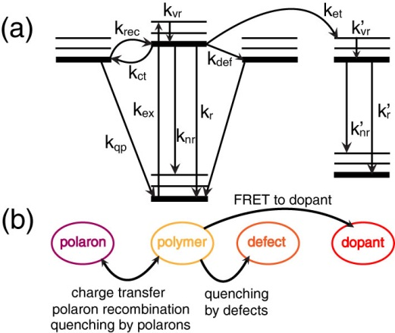
Why Study CPNs? – Photophysics
Background
Many radiative and non-radiative processes occur in CPNs
Conventional radiative/non-radiative decay
Polaron generation/quenching by polarons
Quenching by defects
Energy transfer to dopants
Interested in determining the rates of energy transfer in CPNs

Slide 12
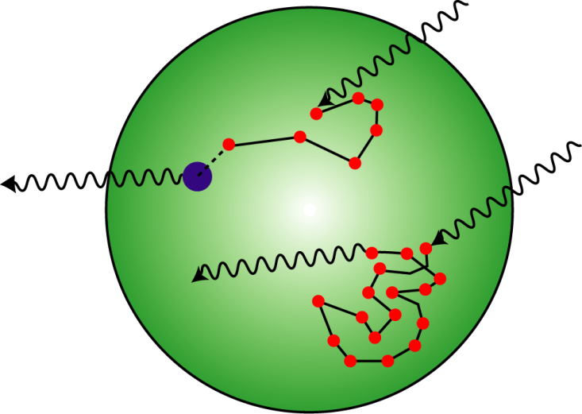
Excited States in Conjugated Polymers & CPNs: Frenkel Excitons
Background
Chromophore
Result of delocalized p_{z} orbitals
Individual chromophores are ~2-8 monomer units in length
Molecular/Frenkel Exciton
Delocalized Excitation
Interacting transition dipoles between adjacent chromophores (perturbation theory)
Frenkel, J. Phys. Rev. 1931, 37, 1276-1294.
Kasha, M. Rawls, H. R., and Ashraf El-Bayoumi, M. Pure Appl. Chem. 1965, 11, 371-392

Slide 13
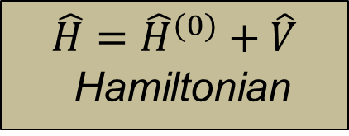
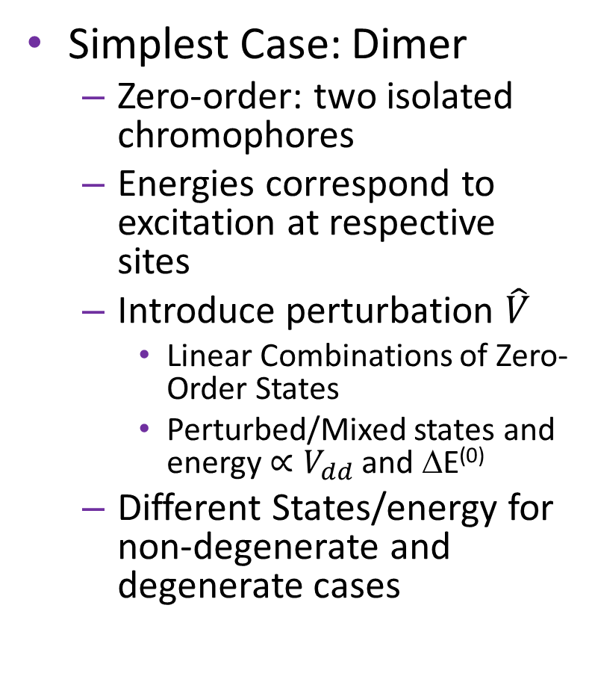
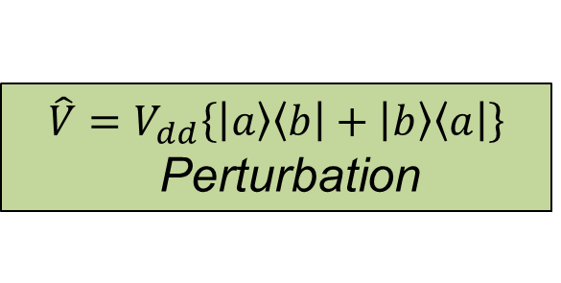
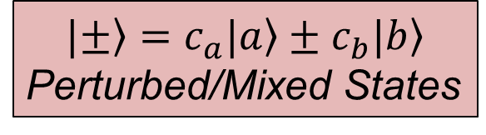
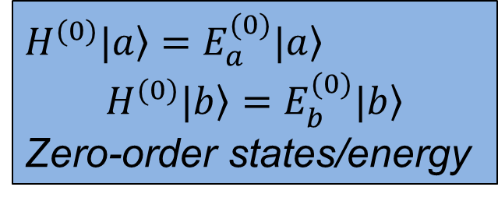
Excited States in Conjugated Polymers & CPNs: Exciton Dimer Model
Background
Simplest Case: Dimer
Zero-order: two isolated chromophores
Energies correspond to excitation at respective sites
Introduce perturbation $\hat{V}$
Linear Combinations of Zero-Order States
Perturbed/Mixed states and energy $∝V_{dd}$ and ΔE⁽⁰⁾
Different States/energy for non-degenerate and degenerate cases
$$\hat{H}={\hat{H}}^{(0)}+\hat{V}$$
Hamiltonian
$H^{(0)}{\left.|a\right\rangle =E}_{a}^{(0)}\left.|a\right\rangle$
$$H^{(0)}\left.|b\right\rangle =E_{b}^{(0)}\left.|b\right\rangle$$
Zero-order states/energy
$${\hat{V}=V}_{dd}\left\{\left|\left.a\right\rangle \left\langle b\right.\right|+\left|\left.b\right\rangle \left\langle a\right.\right|\right\}$$
Perturbation
$$|\left.±\right\rangle =\left.c_{a}|a\right\rangle ±\left.c_{b}|b\right\rangle$$
Perturbed/Mixed States
Atkins, P.; Friedman, R. Molecular Quantum Mechanics; Fourth ed.; Oxford University Press: New York, 2005

Slide 14
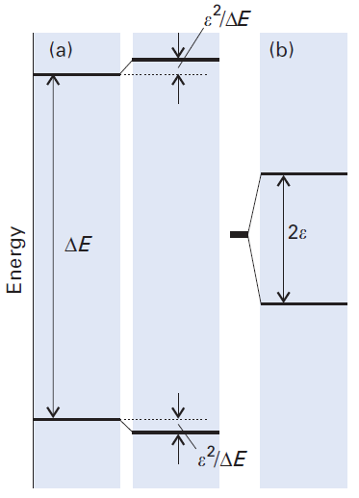
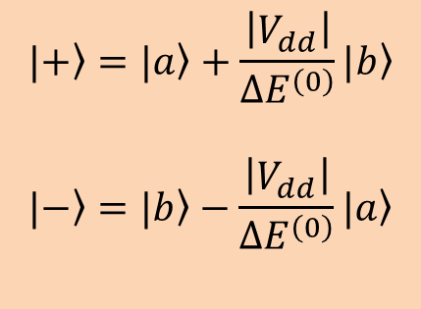
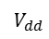
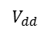
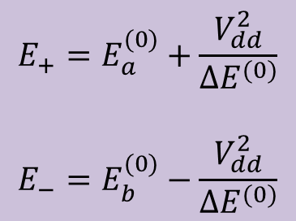
Excited States in Conjugated Polymers & CPNs: Exciton Dimer Model
Background
Non-degenerate chromophores
Weakly mixed states
Small energy shift
Incoherent energy transport (FRET)
Degenerate Chromophores
Evenly mixed states
Large energy shift
Coherent energy transport
$$V_{dd}$$
$$|\left.+\right\rangle =|\left.a\right\rangle +\frac{\left|V_{dd}\right|}{ΔE^{\left(0\right)}}|\left.b\right\rangle$$
$$|\left.−\right\rangle =|\left.b\right\rangle −\frac{\left|V_{dd}\right|}{ΔE^{\left(0\right)}}|\left.a\right\rangle$$
$$E_{+}=E_{a}^{(0)}+\frac{V_{dd}^{2}}{ΔE^{(0)}}$$
$$E_{−}=E_{b}^{(0)}−\frac{V_{dd}^{2}}{ΔE^{(0)}}$$
$$V_{dd}$$
Atkins, P.; Friedman, R. Molecular Quantum Mechanics; Fourth ed.; Oxford University Press: New York, 2005

Slide 15
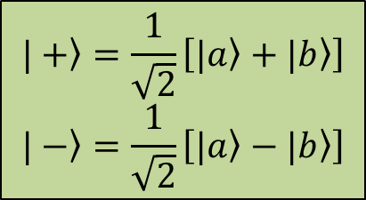
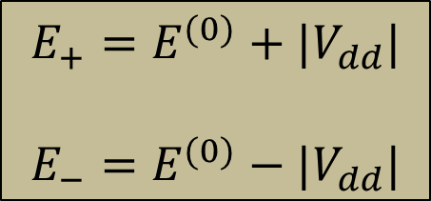
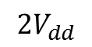
Excited States in Conjugated Polymers & CPNs: Exciton Dimer Model
Background
Non-degenerate chromophores
Weakly mixed states
Small energy shift
Describes incoherent energy transport (FRET)
Degenerate Chromophores
Evenly mixed states
Large energy shift
Describes coherent energy transport
$$\left.|+\right\rangle =\frac{1}{\sqrt{2}}\left[\left.|a\right\rangle +\left.|b\right\rangle \right]$$
$$\left.|−\right\rangle =\frac{1}{\sqrt{2}}\left[\left.|a\right\rangle −\left.|b\right\rangle \right]$$
$$E_{+}=E^{(0)}+{|V}_{dd}|$$
$$E_{−}=E^{(0)}−{|V}_{dd}|$$
$$2V_{dd}$$
Atkins, P.; Friedman, R. Molecular Quantum Mechanics; Fourth ed.; Oxford University Press: New York, 2005

Slide 16
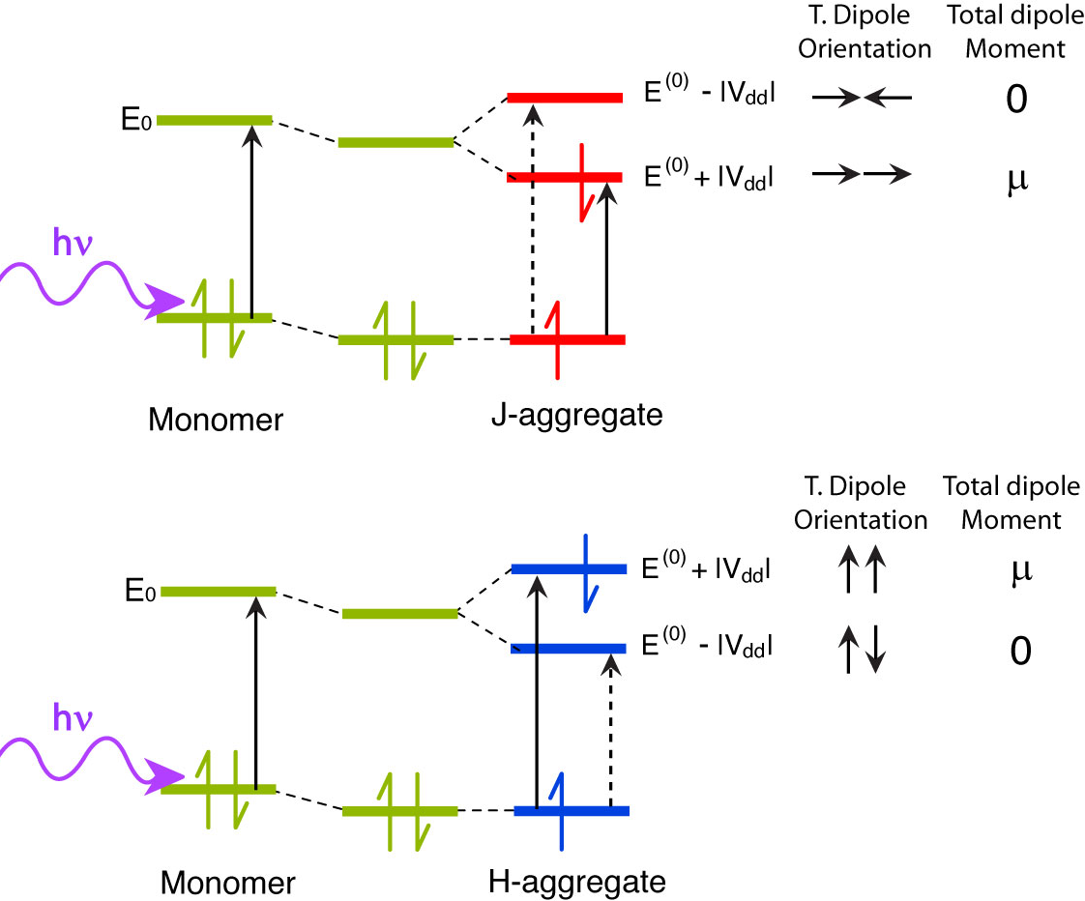
Excited States in Conjugated Polymers & CPNs: Light and Dark Exciton States
Background
Transition dipole coupling splits energy levels of chromophores
T. dipole orientation dictates which state contributes to emission signal
Related to molecular orientation
Nonzero transition dipole vector sum → emissive state
Basis of H- and J-aggregate spectral characteristics
Jelley, E. E. Nature (London) 1937, 139, 631-632.
Wurthner, F., Kaiser, T. E., and Saha-Moller, C. R. Angew. Chem. Int. Edit. 2011, 50, 3376-3410.

Slide 17
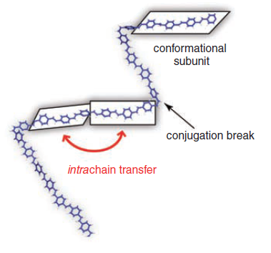
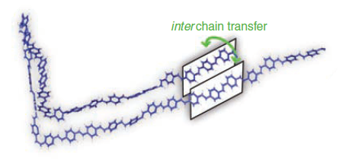
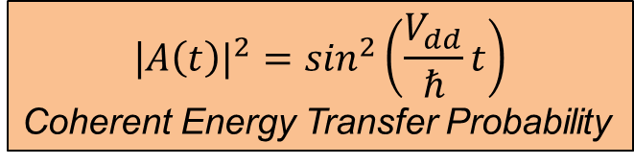
Excited States in Conjugated Polymers & CPNs: Exciton Transport
Background
Two types of energy transport
Coherent transport
Degenerate Chromophores
No/low disorder
Strong coupling
Low T
Oscillating excitation across chromophores (fs time scale)
$${\text{|}A\left(t\right)|}^{2}=\sin^{2}\left(\frac{V_{dd}}{ℏ}t\right)$$
Coherent Energy Transfer Probability
Loudon, R. The Quantum Theory of Light; Third ed.; Oxford University Press, 2000
Collini, E., and Scholes, G. D., Science 2009, 323, 369-373.

Slide 18
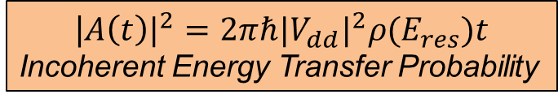
Excited States in Conjugated Polymers & CPNs: Exciton Transport
Background
Two types of energy transport
Incoherent transport
Non-degenerate chromophores
Significant disorder
Weak coupling
High (e.g. room) T
Energy transfer along or between chains, or to dopants (ps time scale)
$${\text{|}A\left(t\right)|}^{2}=2πℏ{{|V}_{dd}|}^{2}ρ(E_{res})t$$
Incoherent Energy Transfer Probability
Collini, E., and Scholes, G. D., Science 2009, 323, 369-373.
Atkins, P.; Friedman, R. Molecular Quantum Mechanics; Fourth ed.; Oxford University Press: New York, 2005

Slide 19
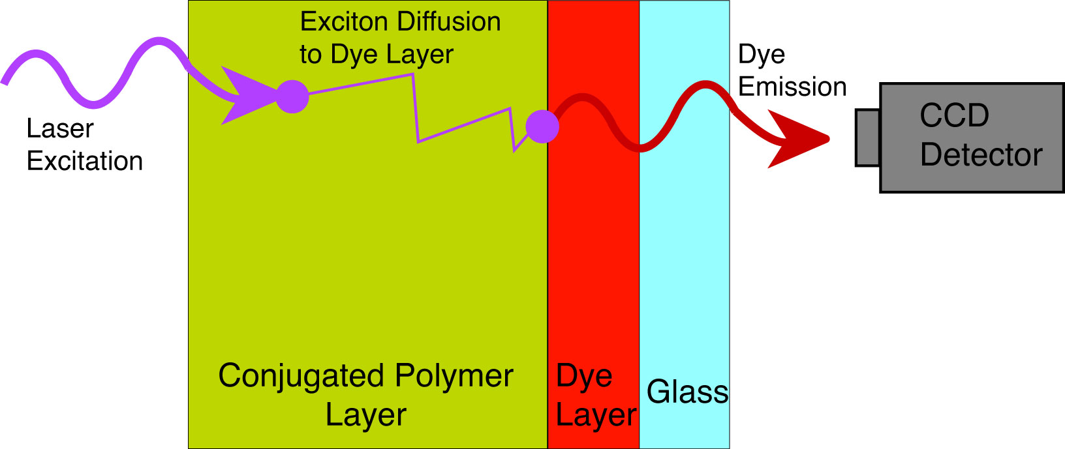
Conventional Exciton Diffusion Length Measurement
Background
Exciton Diffusion Length
Length exciton is transported during exciton lifetime
Measured using doped or layered film samples, or direct imaging methods (e.g. NSOM)
CPNs exhibit similar photophysics to thin films
Fewer challenges/pitfalls compared to films
Pinholes in film (direct acceptor excitation)
Optical penetration depths > length scales of energy transport
Layer segregation issues
Quenching by surface plasmons of metal anode/cathode (in electroluminescent samples)
Lunt, R. R., Giebink, N. C., Belak, A. A., Benzinger, J. B., and Forrest, S. R. J. Appl. Phys. 2009, 105, 053711-053717.
McNeill, J. D., O’Connor, D. B., and Barbara, P. F. J. Chem. Phys. 2000, 112, 7811-7821.

Slide 20
CPN Photophysics
Background
Want a model that can explain the complex photophysics of CPNs
Exciton Diffusion Energy Transfer Model
Want to understand the underlying rate processes in CPNs as well as the length and time scales of nanoscale events in CPNs
Aid in optimizing CPNs for imaging applications and photovoltaic/OLED applications
Utilize a variety of time-resolved techniques to address these issues from multiple angles

Slide 21

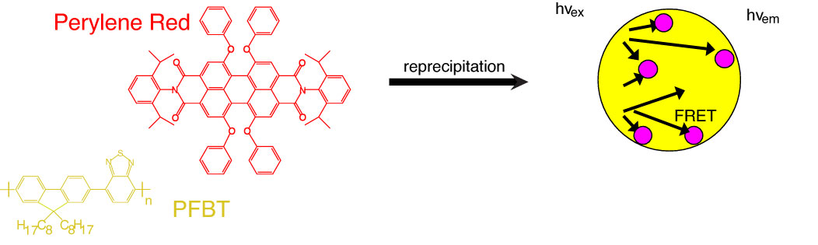


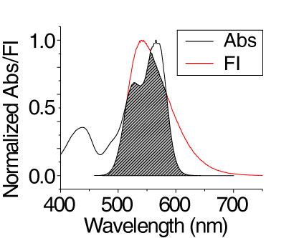
Red-shifted CPNs via Förster Resonance Energy Transfer
Dye-Doped PFBT CPNs
PFBT – Host Polymer
Very photostable (~10⁹ photons/CPN emitted before photobleaching)
High quantum yield (0.66 in THF)
Broad emission spectrum
Perylene Red – Nonpolar dye dopant
High quantum yield (0.98 in DCM)
Laser dye – highly photostable
Excellent spectral overlap with PFBT
Red-shifted emission spectrum
Groff, L. C., Wang, X., McNeill, J. D., J. Phys. Chem. C 2013, 117, 25748.

Slide 22
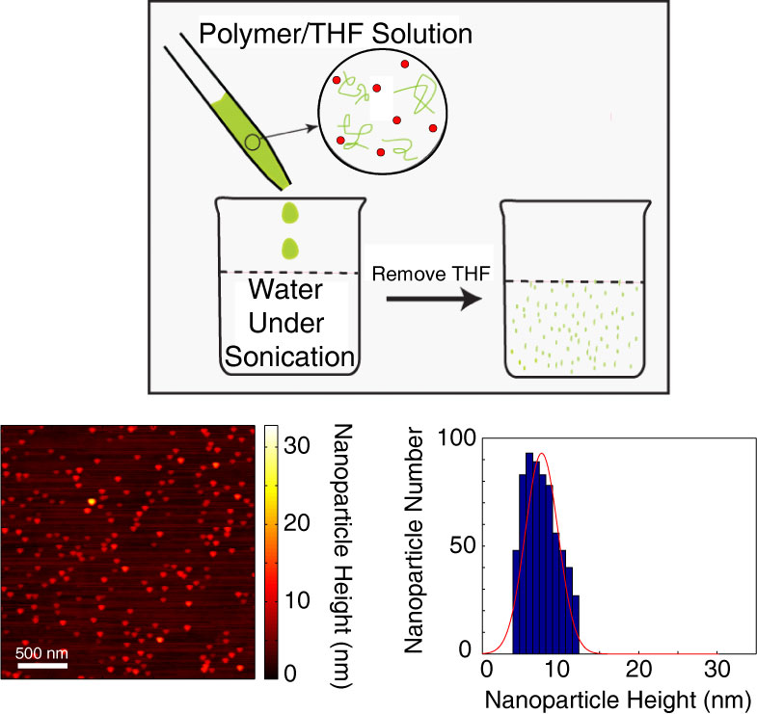
Preparing Dye-doped CPNs
Dye-Doped PFBT CPNs
Reprecipitation method
Polymer/dye dissolved in THF
Dilute solution
Rapidly mix with water under sonication (30 s)
Remove THF and filter to remove large aggregates
Mean particle size ~10 nm
Groff, L. C., Wang, X., McNeill, J. D., J. Phys. Chem. C 2013, 117, 25748.

Slide 23
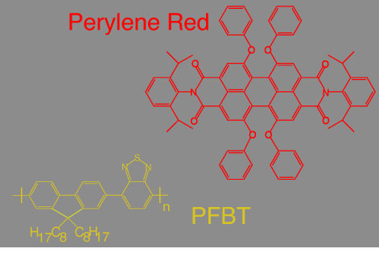
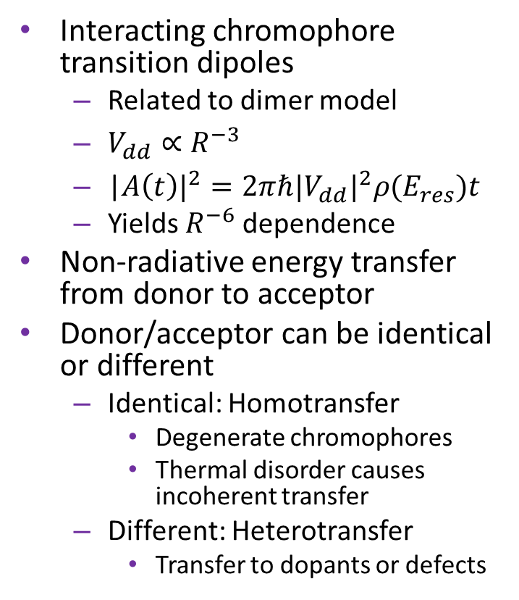
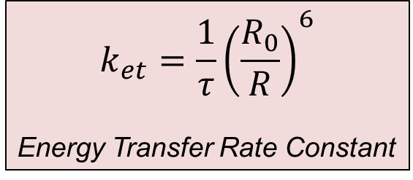
Förster Resonance Energy Transfer
Dye-Doped PFBT CPNs
Interacting chromophore transition dipoles
Related to dimer model
$V_{dd}∝R^{−3}$
${\text{|}A\left(t\right)|}^{2}=2πℏ{{|V}_{dd}|}^{2}ρ(E_{res})t$
Yields $R^{−6}$ dependence
Non-radiative energy transfer from donor to acceptor
Donor/acceptor can be identical or different
Identical: Homotransfer
Degenerate chromophores
Thermal disorder causes incoherent transfer
Different: Heterotransfer
Transfer to dopants or defects
$$k_{et}=\frac{1}{τ}{\left(\frac{R_{0}}{R}\right)}^{6}$$
Energy Transfer Rate Constant
Lakowicz, J. R., Principles of Fluorescence Spectroscopy. Third ed.; New York, 2006.
Förster, T. Ann. Phys. 1948, 437, 55-75.

Slide 24
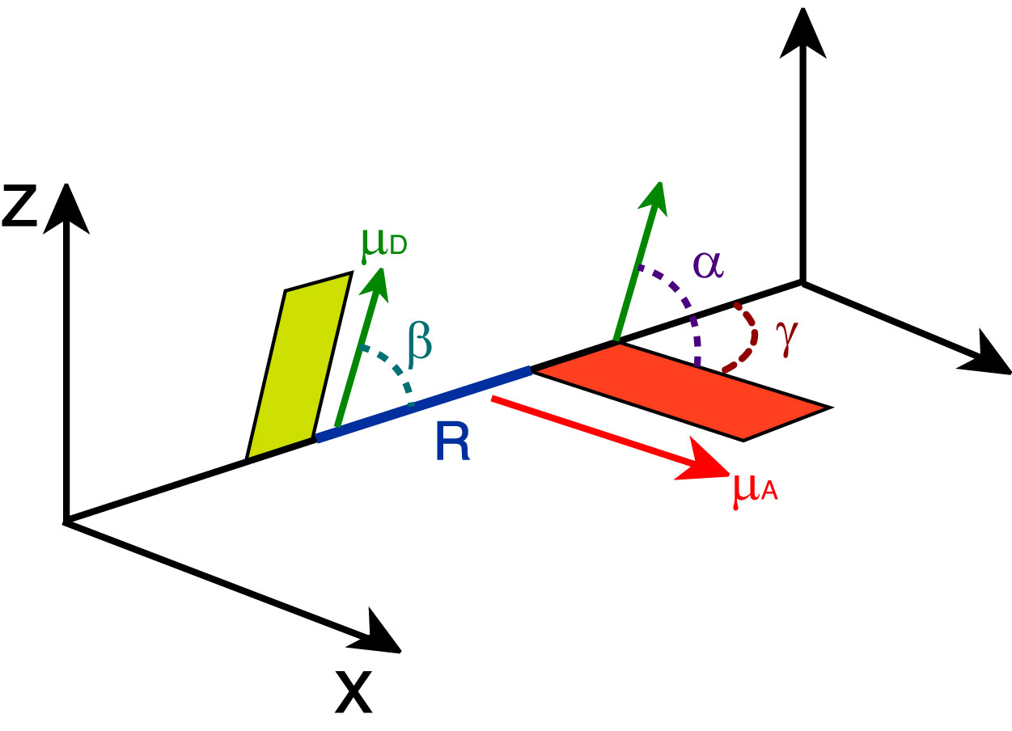
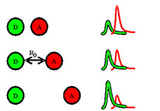
Förster Resonance Energy Transfer
Dye-Doped PFBT CPNs
Energy transfer efficiency depends on spectral overlap, distance between donor/acceptor and orientation
Scales as R⁻⁶
Useful as “molecular ruler”
Förster Radus (R₀)
Distance at which energy transfer efficiency = 50%
Typically < 10 nm
http://bio.physics.illinois.edu/newTechnique.html
Lakowicz, J. R., Principles of Fluorescence Spectroscopy. Third ed.; New York, 2006.
Stryer, L. Annu. Rev. Biochem. 1978, 47, 819-846.

Slide 25
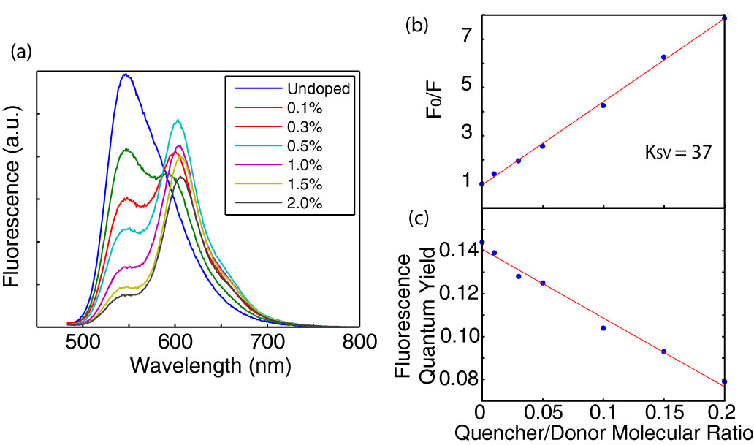
Red-shifted, High Quantum Yield Dye-doped CPNs
Dye-Doped PFBT CPNs
Efficient quenching of PFBT emission by perylene red
86% quenching at 2% perylene red
Quenching obeys Stern-Volmer equation
Perylene red emission red-shifts with increasing doping
Aggregation quenching of acceptor at higher concentrations
Dynamic Quenching
Likely due to dye dimers in CPNs (J-aggregates)
Stern-Volmer Equation
Groff, L. C., Wang, X., McNeill, J. D., J. Phys. Chem. C 2013, 117, 25748.

Slide 26
Red-shifted, High Quantum Yield Dye-doped CPNs
Dye-Doped PFBT CPNs
Successfully red-shifted particle emission
CPN quantum yield not substantially reduced from 0.1% to 1% doping while ET is high
Photostability may be improved by doping
Saturated emission rate may also be improved by doping
Stern-Volmer Equation
Groff, L. C., Wang, X., McNeill, J. D., J. Phys. Chem. C 2013, 117, 25748.

Slide 27
Fluorescence Quenching and Lifetimes
Dye-Doped PFBT CPNs
It is evidenced by fluorescence spectra that perylene red efficiently quenches emission
Is this quenching static or dynamic?
What are the fluorescence lifetimes of the doped samples?
Previous work indicates PFBT CPN lifetimes on the picosecond time scale
Do these samples exhibit complex decay kinetics?
What is the correct physical picture in terms of rate processes?
C. Wu, J. McNeill et al., ACS Nano, 2008, 2, 2415

Slide 28
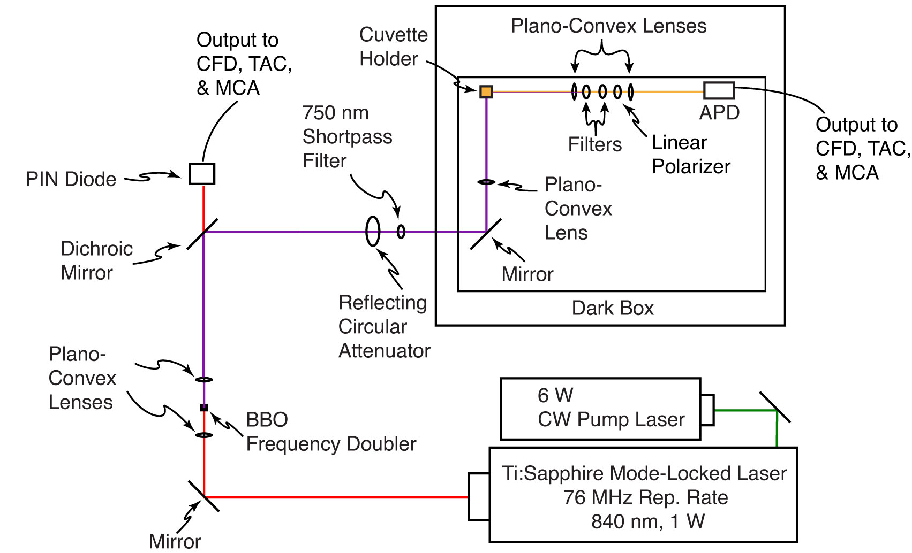
Picosecond Time-Correlated Single-Photon Counting (TCSPC) Spectroscopy
Dye-Doped PFBT CPNs
Ultrafast, mode-locked, pulsed Ti:Sapphire laser source
~70 ps time resolution
Frequency doubled for excitation
Single-photon avalanche diode detector
Fast electronics: arrival time measurements
Histogram of detected photons

Slide 29
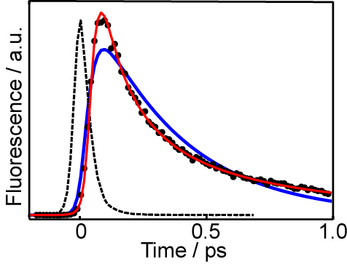
Picosecond Fluorescence Lifetimes of Dye-doped CPNs
Dye-Doped PFBT CPNs
Exponential
Stretched Exponential
Previous experiments indicate CPNs exhibit complex decay kinetics
Stretched exponential lifetime decay
β is an indication of heterogeneity in exciton lifetimes
Number varying between ~0.2 and 1
As β decreases, indicates a broadening distribution of exciton lifetimes
At β = 1, single exponential is recovered
Chen, R. J. Lumin. 2003, 102, 510-518

Slide 30
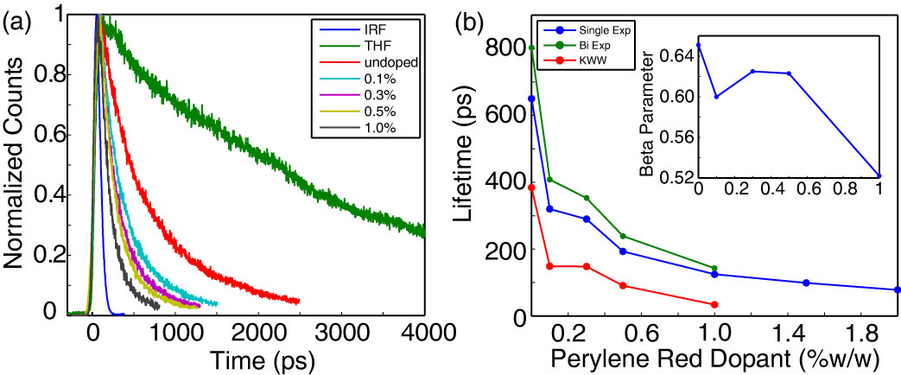
Picosecond Fluorescence Lifetimes of Dye-doped CPNs
Dye-Doped PFBT CPNs
Mean exciton lifetimes reduced by doping (dynamic quenching)
PFBT in THF fits well to single exponential (3 ns lifetime)
CPNs fit best to bi-exponential and stretched exponential decays
Decreasing trend in β as doping increases
Dynamic self-quenching of perylene red emission at high doping ratios
Decreasing trend in β indicates a broadening distribution of exciton lifetimes as doping increases
Agrees qualitatively with physical picture of exciton multiple energy transfer
Range of exciton transfer distances broadens lifetime distribution
Groff, L. C., Wang, X., McNeill, J. D., J. Phys. Chem. C 2013, 117, 25748.

Slide 31
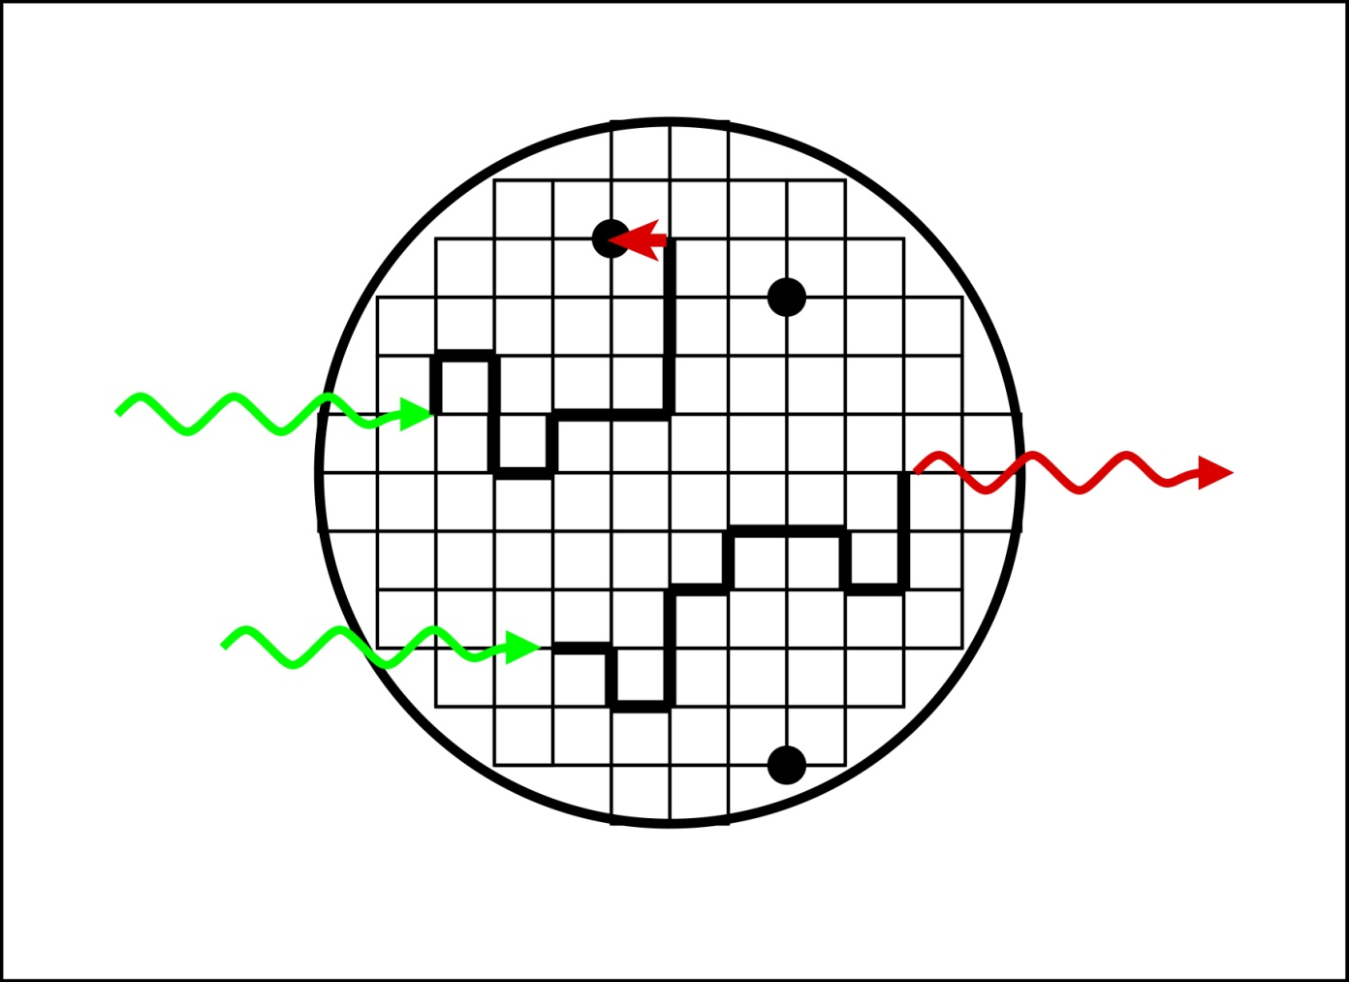


Dye-Doped PFBT CPNs
Exciton Diffusion and FRET
Random Walk Model
Multichromophoric system--Frenkel Exciton
Excitons hop from site to site: hopping between polymer chains and segments, exciton transfers to dyes, quenchers or defects--Exciton diffusion
Hole polaron generation
emission/decay
Exciton transport modeled as a 3D random walk confined to a sphere
Results: excited state dynamics, quenching efficiency, blinking, twinkling
quencher
excitation
emission
diffusion path
C. Wu, J. McNeill et al., J. Phys. Chem. C, 2008, 112, 1772

Slide 32
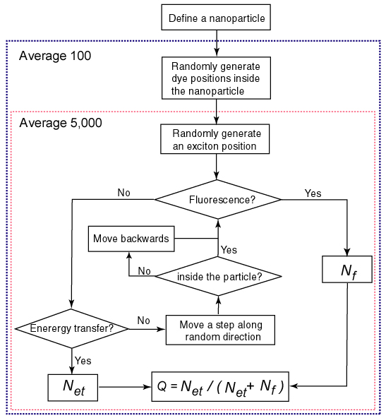
Dye-Doped PFBT CPNs
Exciton Diffusion Energy
Transfer Model for Dye-doped NPs
FRET rate
Radiative emission rate
Exciton diffusion
Gaussian RNG
Displacement per Δt
Average over many exciton trajectories and quencher positions
Results: Quenching efficiencies, Fluorescence decay kinetics
C. Wu, J. McNeill et al., J. Phys. Chem. C, 2008, 112, 1772

Slide 33

Modeling of Dye-Doped PFBT Fluorescence
Dye-Doped PFBT CPNs
Average over many excitons, particles, quencher positions
3000 excitons per particle, 50 particles per data point
Poisson distribution of defects and quenchers
Exciton diffusion length L_{D} = 12 nm, Förster radius R₀ = 4 nm
Approximate match to experimental TCSPC fitting results
At 0% dopant, 2.3 defect quenchers (dye equivalents) present
β reduced by implementing Poisson statistics
Ignoring quenching by defects results in L_{D} 2x lower, lower quality of agreement
Groff, L. C., Wang, X., McNeill, J. D., J. Phys. Chem. C 2013, 117, 25748.

Slide 34
Dye-Doped PFBT CPNs: Summary
Dye-Doped PFBT CPNs
Successfully red-shifted emission via dye-doping
High energy transfer efficiency and Φ at moderate doping
Nanoparticle samples exhibit complex decay kinetics
Described best by bi-exponential or KWW dynamics
Decreased lifetimes in doped samples (dynamic quenching)
Acceptor is dynamically quenched at high doping ratios
Exciton diffusion, Energy Transfer Model matches experimental dynamics well
Poisson distribution of defects and quenchers
~2 defects/CPN
Length scale of exciton transport ~12 nm for PFBT (D = 8x10⁻⁹ m² s⁻¹)
C. Wu, J. McNeill et al., ACS Nano, 2008, 2, 2415

Slide 35
Solvent-Induced Swelling of CPNs
Solvent-Induced Swelling
Rapid mixing with
water, THF Removal
conjugated polymer film
conjugated polymer nanoparticle
conjugated polymer in solution
THF Addition
Use solvent-induced swelling methods to probe the changes in nanoparticle photophysics
Probe rates of multiple energy transfer
Determine nature of quenching defects (aggregates vs. oxidative)
Rate of exciton motion hypothesized to be amplified for CPNs
Densely packed chromophores
Access to more nearest neighbor chromophores in CPNs vs. polymer in solution
Probe via fluorescence anisotropy decay (FAD) and modeling

Slide 36


Fluorescence Quantum Yield and Spectral Shifting
Solvent-Induced Swelling
MEH-PPV
Increase in Φ as %THF increases
~92% quenching at 0% THF
Φ_{THF} is recovered at high THF concentrations
Normalized spectra show progressive blue shifting of emission peak
~5 nm for PFBT
~40 nm for MEH-PPV
Stronger dipole coupling in MEH-PPV
PFBT
MEH-PPV
PFBT
Groff, L. C., Jiang, Y., Wang, X., and McNeill, J. D. 2015, In final preparation.

Slide 37

Fluorescence Decay Kinetics of Swelled CPNs
Solvent-Induced Swelling
MEH-PPV
PFBT
Exciton lifetimes increase with increasing THF volume fraction
PFBT in THF fits well to single exponential (3 ns lifetime)
All others fit best to bi-exponential and stretched exponential decays
β increases with increasing THF, except PFBT in 80% THF
Increasing trend in β indicates a narrowing distribution of exciton lifetimes as THF fraction increases
Multiple energy transfer is FRET mediated (R⁻⁶ dependence)
As CPN structure swells, neighboring chromophores become less accessible, reducing exciton mobility.
Groff, L. C., Jiang, Y., Wang, X., and McNeill, J. D. 2015, In final preparation.

Slide 38
Fluorescence Decay Kinetics of Swelled CPNs
Solvent-Induced Swelling
MEH-PPV
PFBT
Evidence for possible dynamic equilibrium between CPNs and unassociated polymer
Drastic decrease in β to ~0.2 at 80% THF for PFBT suggests sudden increase in lifetime distribution
Bi-exponential fitting results
PFBT Short time constant ~ CPN lifetime (~275 ps)
PFBT Long time constant ~ polymer lifetime (~3 ns)
Weighted amplitudes shift for higher THF concentrations
Similar lifetime behavior for MEH-PPV between 40-60% THF.
Groff, L. C., Jiang, Y., Wang, X., and McNeill, J. D. 2015, In final preparation.

Slide 39



Probing Energy Transport via Fluorescence Anisotropy Decay
Solvent-Induced Swelling
Challenge: Indistinguishable chromophores
Energetically degenerate, or near-degenerate
TCSPC can measure kinetics
Need method of measuring rate of energy transfer
Time-resolved fluorescence anisotropy decay
Emission polarization is altered: rotational dynamics or energy transfer
Typical uses: rotational diffusion of macromolecules, small molecules
Polarization changes due to energy homotransfer events
$τ_{r}∝1/D_{r}$ (ns-µs), depending on particle size
$τ_{r}≫τ_{CPN}$ for 10 nm particle
Rotational motion is negligible for CPNs
$$D_{r}=\frac{k_{b}T}{8πηr^{3}}$$
Stokes-Einstein Equation
$$r\left(t\right)=\frac{I_{0}(t)+I_{90}\left(t\right)}{I_{0}(t)−2I_{90}(t)}$$
Fluorescence Anisotropy Decay
Equation
Cross, A. H., Fleming G. R., Biophys. J. 1984, 46, 45-56.
Beechem, J. M., Brand, L. Annu. Rev. Biochem. 1985, 54, 43-71

Slide 40

Polarization Loss via Exciton Diffusion
Proposed Research
Polarized excitation source
CPNs possess randomly oriented transition dipoles
Preferentially excite chromophore transition dipoles aligned relative to excitation
FRET to neighboring chromophore with imperfectly aligned transition dipole
Each ET event alters polarization
Emission polarization depends on T. dipole alignment prior to decay
Measure intensity decays at 0°, 90°, 55° polarizations to construct ansiotropy decay
Fundamental Questions
How many transfer events occur within the exciton lifetime?
What is the length scale of these transfers?
Groff, L. C., Jiang, Y., Wang, X., and McNeill, J. D. 2015, In final preparation.

Slide 41

Picosecond Fluorescence Anisotropy Decay
Solvent-Induced Swelling
Measure fluorescence polarization loss as a function of time
Collect intensity decays at 0°, 90°, 55° polarizations relative to excitation source
Rotational diffusion does not affect polarization loss
Polarization loss due to multiple energy transfer of excitons
Intricate fitting analysis to extract anisotropy parameters
Convolution fitting of polarized intensity decays
Determine limiting anisotropy r₀ and correlation time τ_{c} from fit results
r₀ gives information about transition dipole alignment at t₀
Able to measure rate constant k_{et} from correlation time, τ_{c}
Groff, L. C., Jiang, Y., Wang, X., and McNeill, J. D. 2015, In final preparation.
Cross, A. J., and Fleming, G. R., Biophys. J. 1984, 46, 45.

Slide 42
Picosecond Fluorescence Anisotropy Decay
Solvent-Induced Swelling
Multiple energy transfer rate constant amplified in CPNs
For moderately swelled PFBT CPNs (above) k_{et} ~3x10¹⁰ s⁻¹
For PFBT in THF, k_{et} ~1x10⁹ s⁻¹
Hypothesized to be due to quantity of nearest neighbor chromophores to move between
6 neighbors in CPNs, allow for motion along or between chains
2 neighbors in linear polymer, motion is restricted along chain
Groff, L. C., Jiang, Y., Wang, X., and McNeill, J. D. 2015, In final preparation.

Slide 43

Discrete Lattice Modeling of Nanoparticle Swelling
Solvent-Induced Swelling
Model Details
Cubic lattice
Energy transfer probability $∝$ chromophore densities
Initial lattice spacing determined from chromophore densities at ~1 nm
Defects/quenchers added to unswelled lattice until Φ_{CPN,} τ_{CPN} reproduced
R_{q} = 4 nm
~10 defects per CPN for both polymers
Oxidized defects assumed (defects present regardless of chromophore density)
Quenching efficiency η defined via fluorescence quantum yield
Multiple energy transfer probability
Defined from Random Walk
As lattice spacing increases,
p_{et} reduced by f ^{4/3}
Experimental quenching efficiency
Förster, T. Ann. Phys. 1948, 437, 55-75
Bardeen, C. J. Annu. Rev. Phys. Chem. 2014, 65, 127-148.
Groff, L. C., Jiang, Y., Wang X., and McNeill, J. D. 2015, in final preparation.

Slide 44


Lattice Modeling Results
Solvent-Induced Swelling
Model reproduces experimental η, τ well
For low to moderate %THF
β reproduced well for PFBT
Model/experiment divergence at mid/high THF concentrations
ascribed to dynamic equilibrum
absence of nanoparticle dissociation in model
Energy transfer rate constants extracted from p_{et}
CPN ET rate constants 10-60x higher than polymer ET rate constants
Agrees with experimental anisotropy fit results
Agrees qualitatively with Förster exciton diffusion theory
Reduced chromophore number density reduces ET rate
MEH-PPV Model Results
PFBT Model Results
Bardeen, C. J. Annu. Rev. Phys. Chem. 2014, 65, 127-148.
Groff, L. C., Jiang, Y., Wang, X., and McNeill, J. D. 2015, In final preparation.

Slide 45
Fluorescence Quantum Yield/Exciton Mobility Tradeoff
Solvent-Induced Swelling
k_{et} is ~2x higher for MEH-PPV CPNs compared to PFBT CPNs
Due to stronger transition dipole coupling in MEH-PPV
Φ is ~4x higher for PFBT CPNs compared to MEH-PPV CPNs
Weaker coupling/more isolated chromophores
Increased exciton motion efficiently funnels excitons to defect quenchers
Reduction in lifetime
Reduction in Φ
Groff, L. C., Jiang, Y., Wang, X., and McNeill, J. D. 2015, In final preparation.

Slide 46
Summary
Successfully prepared redshifted PFBT CPNs with high Φ
Determined L_{D} ~12 nm for PFBT
Successfully used solvent-induced swelling to probe rates of exciton mobility using FAD
Multiple energy transfer amplified 10x-60x in CPNs versus polymer in solution
Lattice model results match well assuming oxidized defect quenchers
Tradeoff between mobility and Φ can be exploited for improvement of organic semiconductor devices

Slide 47


Acknowledgments
Dr. Jason McNeill
McNeill Group
Xiaoli Wang
Yifei Jiang
NSF, NIH
Clemson University Department of Chemistry
You for your time and patience!
http://www.nsf.gov
http://www.nih.gov

Slide 48
Backup slides

Slide 49
Why are the particles nearly spherical?
Pi-conjugated backbone is rigid
Should yield oblong particles / rods
However...
Very hydrophobic: high polymer-water interface tension
Small particle size (High surface/volume ratio)
Favors nearly spherical shape
Confirmed by AFM, TEM, Preliminary Neutron Scattering

Slide 50





Stern-Volmer Derivations
Static Dynamic
$$K_{SV}=\frac{[F−Q]}{\left[F\right][Q]}$$
$${[F]}_{0}=\left[F\right]+[F−Q]$$
$$K_{SV}=\frac{{[F]}_{0}}{\left[F\right]\left[Q\right]}−\frac{1}{[Q]}$$
$$\frac{d{\left[F\right]}^{∗}}{dt}=k_{abs}−\left(k_{f}+k_{q}\left[Q\right]\right){\left[F\right]}^{∗}=0$$
$$\frac{d{[F]}^{∗}}{dt}=k_{abs}−k_{f}{\left[F\right]}_{0}^{∗}=0$$
$$\frac{F_{0}}{F}=\frac{k_{f}+k_{q}[Q]}{k_{f}}=1+k_{q}τ_{0}\left[Q\right]$$
$$F_{0}/F=1+K_{SV}[Q]$$

Slide 51


Useful Equations
Quantum Yield Calc
Quantum Yield (Rates)
Absorption Cross-section
$$∅_{F(x)}=(\frac{A_{s}}{A_{x}})(\frac{F_{x}}{F_{s}}){(\frac{n_{x}}{n_{s}})}^{2}∅_{F(s)}$$
$$∅_{F}=\frac{k_{R}}{k_{R}+k_{NR}}$$

Slide 52


Hole Polarons: Photogeneration and Luminescence Quenching
Background
Quasiparticle, radical cation and local polarization field
caused by reversible photoejection of e⁻
Hole polaron can diffuse between chromophores or recombine with electron
Extremely efficient fluorescence quenchers
One polaron quenches ~90% of fluorescence from a polymer chain of >100 chromophores
Significant quenching at 5x10¹⁷ holes per cm³ of polymer (exceeded in devices)
+
e-
Yu, J., Wu, C. F., Tian, Z. Y., and McNeill, J. D. Nano Lett. 2012, 12, 1300-1306
Yu, J., Song, N. W., McNeill, J. D., Barbara, P. F. Isr. J. Chem. 2004, 44, 127-132.

